Slide 1
JavaScript 101
Week 8

Slide 2
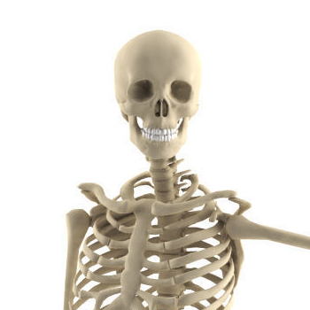
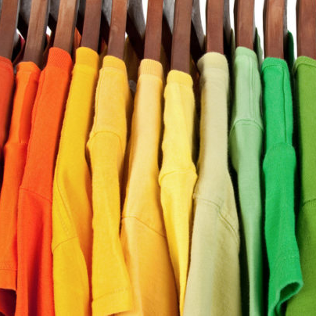
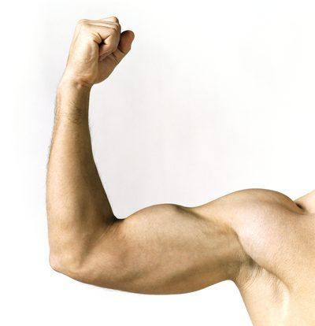
We've passed the halfway point!
HTML
Structure
CSS
Design
JavaScript
Function

Slide 3
JavaScript
Programming language designed in 2 weeks
Not really related to Java
Initially, used to add some interactivity to webpages
Now used everywhere, from servers to IoT devices

Slide 4
What can JavaScript do?
A brief tour of JavaScript’s magic 🚀

Slide 5
Declarative vs. Imperative.
HTML & CSS vs. JavaScript

Slide 6
Get to know the JavaScript Console

Slide 7
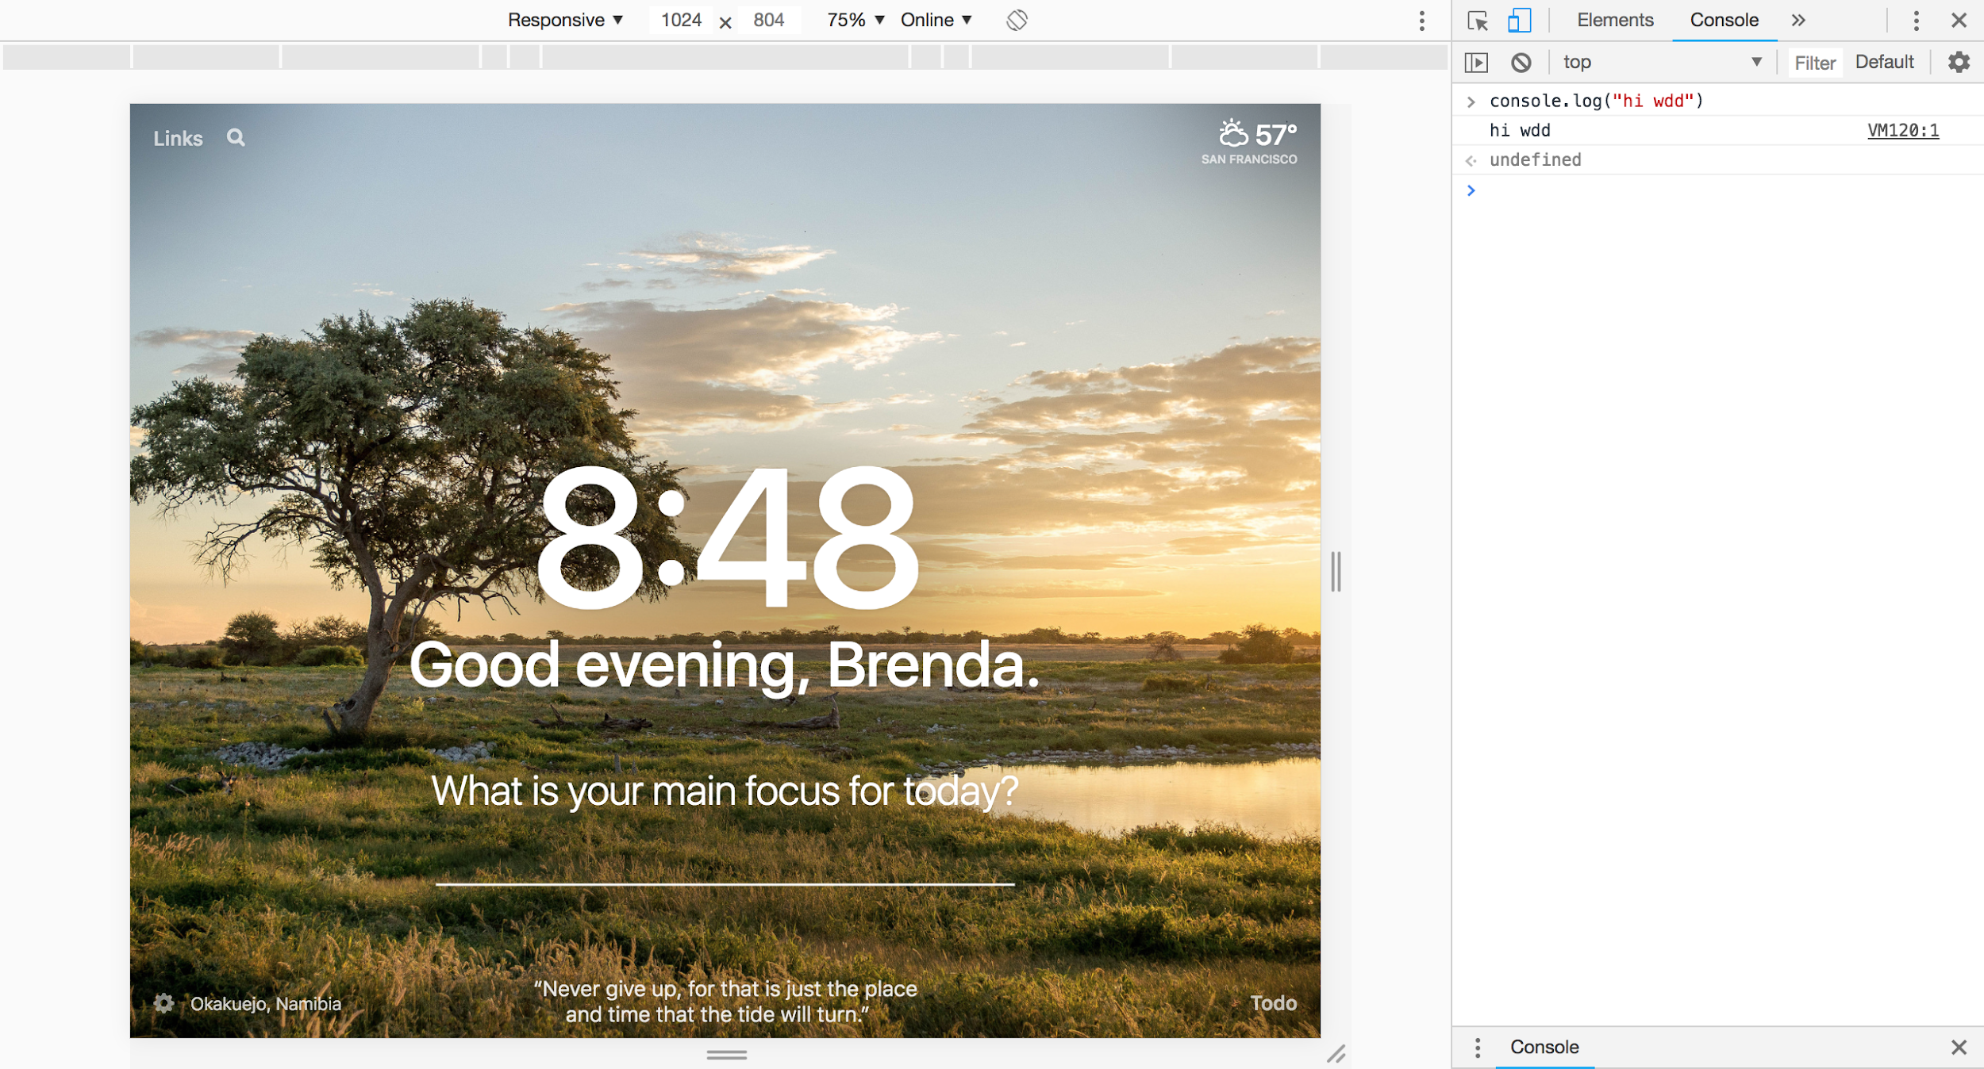

Slide 8
The JS console is your playground,
where you can test ideas.

Slide 9
JavaScript 101
“Printing” things to the console output
console.log(‘blah’);
Comments
// hello, this is a comment.
/* this is also
a comment */

Slide 10
Let’s write some JavaScript!

Slide 11
A few primitive types
The building blocks of JS (and other programming languages)
number: 1, 2, 3, 0.8, 100, 1.6
string: "hello", "wdd", "wowza cool class"
boolean: true, false
Notes:
This doesn’t cover all types ever, but these are the basic ones. You probably won’t need too many other ones for our class.

Slide 12
Number
Examples:
24601 (decimal), 0x3ebd35 (hexadecimal)
Some mathematical operations:
Regular: +, -, *, /
Power: base ** exponent
Modulo: dividend % divisor (reasonable with positive numbers) 5 % 2 == 1 because 5 / 2 == 2 (floor div), remainder 1

Slide 13
Boolean
Two possible values: true, false
Expressions that evaluate to booleans, often times comparisons:
Loose equality operator → ==, !=
1 + 5 == 6 evaluates to true
1 == 2 evaluates to false
1 + 5 != 2 evaluates to true
Other relational operators → >, <, >=, <=

Slide 14
Logic operations
Or → || Just one thing in the expression has to be true
true || false evaluates to true
1 + 1 == 4 || 1 + 1 == 2 evaluates to true
8 == 8 || 1 == 1 evaluates to true
2 == 0 || 1 == 8 evaluates to false
And → && Everything in the expression has to be true
true && false evaluates to false
1 + 1 == 4 && 1 + 1 == 2 evaluates to false
8 == 8 && 1 == 1 evaluates to true
2 == 0 && 1 == 8 evaluates to false

Slide 15
Variables
We can declare (once) variables with unique names to hold values for later use
Format:
let variableName = value;
Example:
let numStudents = 120;
To reassign a different value: (notice that we don't use let here because of reassigning)
numStudents = 120;
// We start with 20 potatoes
let numPotatoes = 20;
// Print it out in the console
console.log("We have", numPotatoes, "potatoes");
// We sold 10 potatoes during the day
// The equal symbol here means assignment
numPotatoes = numPotatoes - 10;
// Print out how much we have left
console.log("We have", numPotatoes, "potatoes");
https://playcode.io/140537?tabs=console&script.js&output
Notes:
You don't need to have the value there at the time you declare a variable.

Slide 16
Constants
Again, we can declare (once) variables with unique names to hold values for later use
Format:
const variableName = value;
Example:
const jacobsFireCode = 140;
Once initialized, we cannot reassign the variable to a different value :(
// A gold potato has a weight of 200 pounds
const goldPotatoWeight = 200;
// Someone comes at night and wanted to change it :(
goldPotatoWeight = 10;
// TypeError:
// Attempted to assign to readonly property.

Slide 17
Let's take 4 minutes for a little practice
https://playcode.io/286149?tabs=console&script.js&output

Slide 18
Functions
Functions are reusable pieces of code We can define our own functions too!
Syntax:
function functionName(arg1, ...) {
// Do something...
return returnValue;
}
function multiply2(number) {
return number * 2;
}
console.log(1); // 1
console.log(multiply2(1)); // 2
console.log(multiply2(multiply2(1))); // 4
let mul2 = multiply2;
console.log(mul2(4)); // 8

Slide 19
HTML 🤝 JavaScript

Slide 20
Linking HTML and JavaScript file
How will the HTML file know where to find its codin’ ?!
At the end of the <body> tag, add this line:
<script src="path/to/your/script.js"></script>
*No need to memorize this — I’d just copy and paste or something like that

Slide 21
Event handling: A primer
<img id="panic-button">
<script type="text/javascript">
function panicButtonClicked() {
alert("Ahh! Somebody just clicked the panic button :o")
}
// We want the browser to run panicButtonClicked() for us when someone clicks
// the button with id "panic-button"
document.getElementById("panic-button").onclick = panicButtonClicked;
</script>
https://playcode.io/140602?tabs=script.js&output

Slide 22
Setting inline style in JavaScript
<img id="pumpkin">
<div>Width: <input id="pumpkin-width" type="range" min="10" max="200" value="100"></div>
<script type="text/javascript">
// Note that document.getElementById("id-of-some-element") gives you an element
// Then you can use element.style.cssPropertyName = cssPropertyValue to change its style
function pumpkinSizeUpdated() {
const width = document.getElementById("pumpkin-width").value;
const pumpkin = document.getElementById("pumpkin");
pumpkin.style.width = width + "px";
}
// We want the browser to run pumpkinSizeUpdated() when the range slider is changed immediately
document.getElementById("pumpkin-width").oninput = pumpkinSizeUpdated;
</script>
See demo on next slide…

Slide 24
Notes:
also we know the site gets laggy but its not that hard to take a picture and remember it

